Slide 1
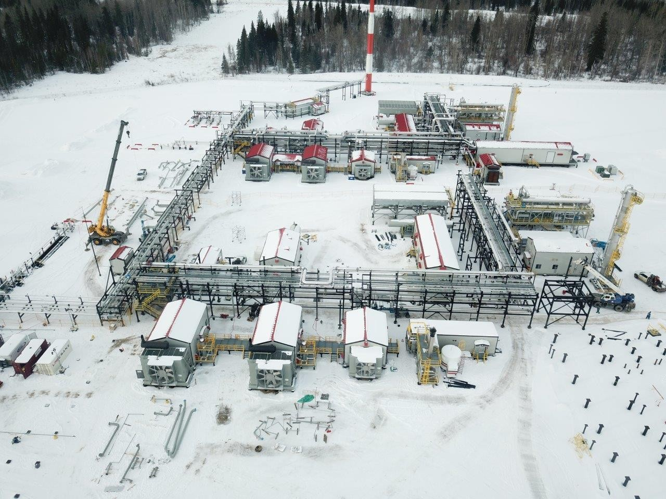

Introduction to Startec

Slide 2
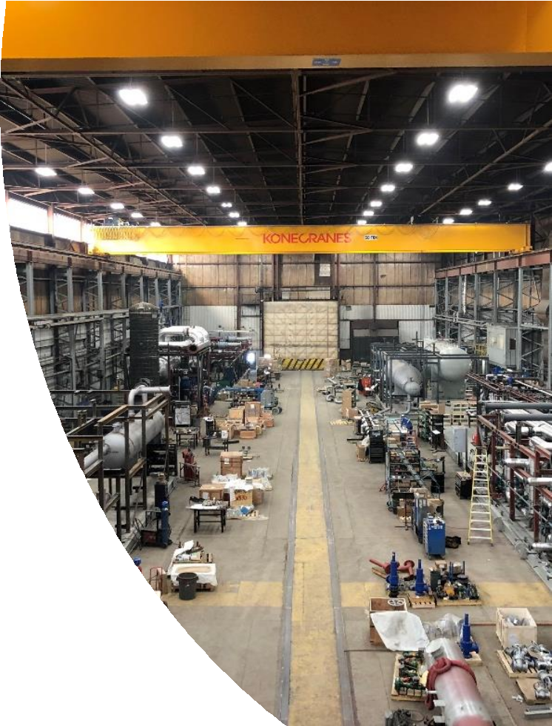
Startec Compression &
Process Introduction
Startec Background:
Founded in 1976
103,000 square foot fabrication facility on a 16- acre property
Startec Service - commercial, recreational and industrial refrig. design, construction and service
Startec C&P specializes in engineered and fabricated process solutions for the energy industry
2

Slide 3
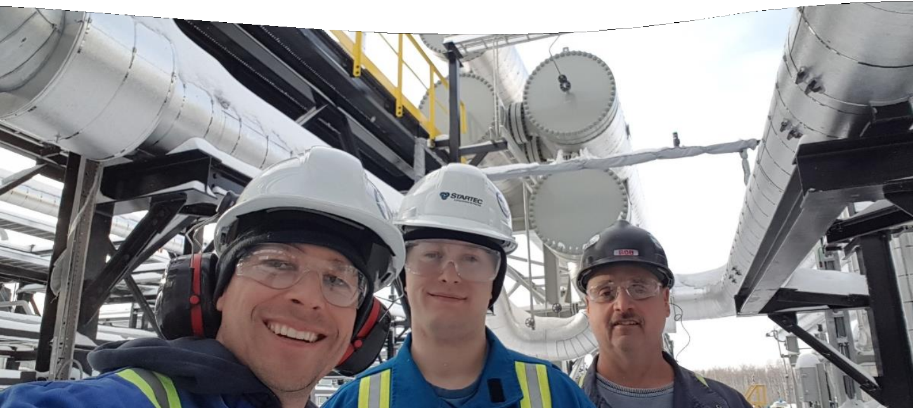
Startec
Engineered Solutions (from conceptual design to marketable
product)
Engineering, Design, Procurement and Fabrication
Project Management and Execution
Commissioning, Start-up and Maintenance
Process Optimization and Facility Debottlenecking
Solutions
2

Slide 4
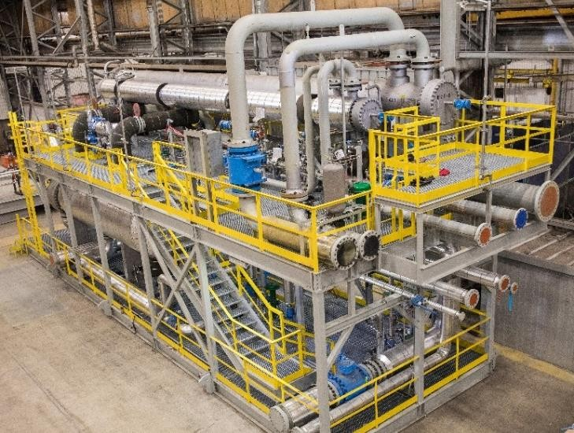
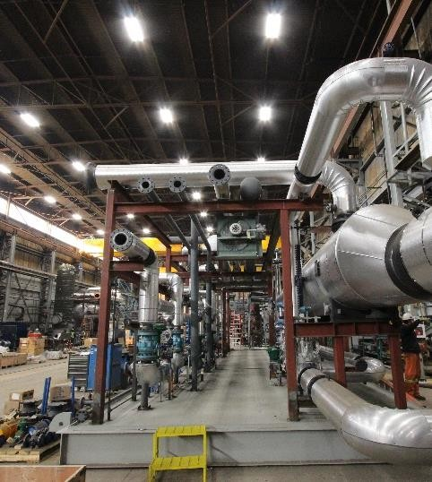
Startec Compression & Process – Products
Startec has the in-house capability to design and build customized fit-for-purpose equipment for any processing application
Gas Processing:
Refrigeration & Liquefication
  MRU
  Cryo
Compression
  Screw, Reciprocating, Centrifugal
Stabilizers
Gas Treating
  Amine Sweetening
  Dehy
Fractionation
Heavy Oils:
DRU
Product Cooling
Energy Transition
Biofuels
Gas to Liquids (GTL)
CO₂ Capture
Flare Gas Capture
CNG
General purpose
Heat Exchangers
Fuel Gas Conditioning
Industrial Gas Processing

Slide 5
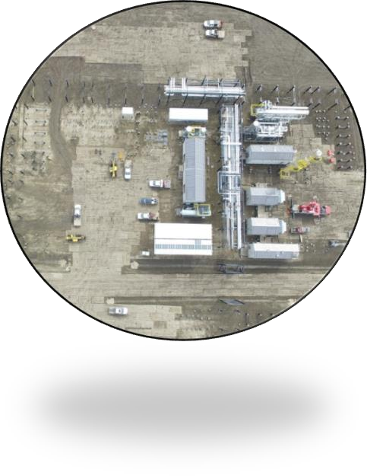
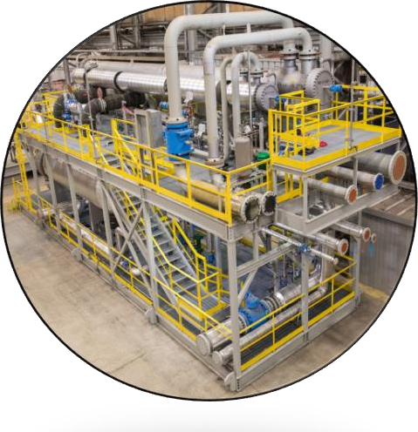
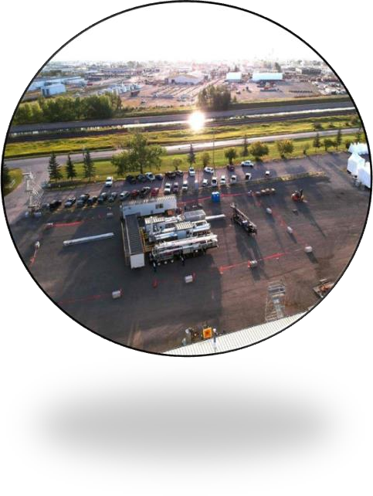
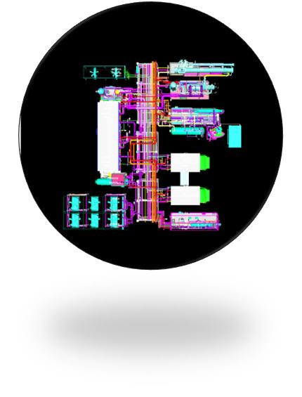
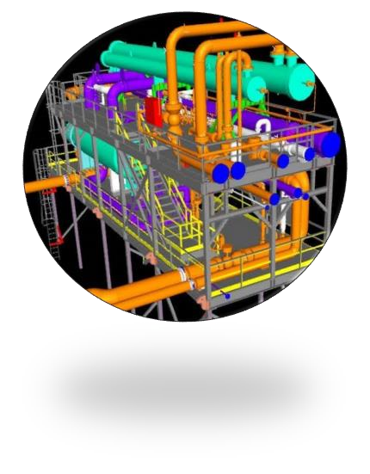
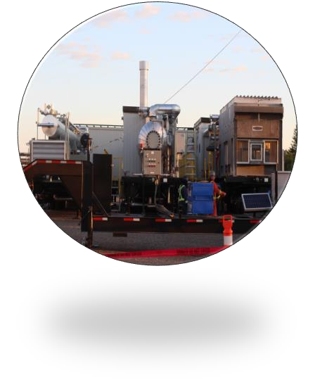
Modularized Designs
200mmcf/d gas processing facility
200mmcf/d gas processing facility
4MMcf/d Trailerized mobile gas processing facility
All designs not only contemplate the operating environments they work in, they also contemplate how the equipment has to get there, saving project time and money

Slide 6
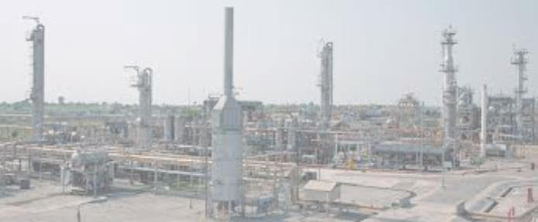
Case Study:
Modularized Gas Processing Facility for International Client

Slide 7
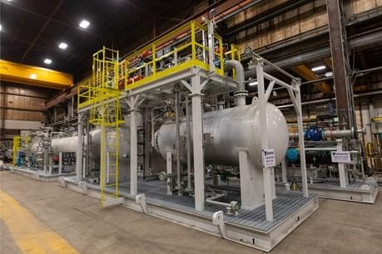
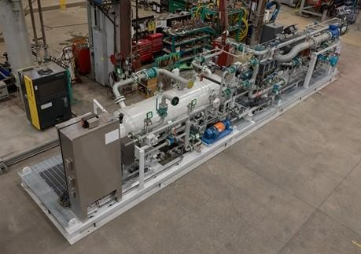
Modularized Designs-International
International Client was looking for a purpose-fit solution to support their gas processing capability
Startec Scope:
48mmscfd gas processing/power generation facility
Three (3) x 50% Frick Screw Compression
Machines with 750 HP Motors
Accumulator/Receiver skid,
Suction Scrubber & Economizer Skid
PSV platform skid. Also, part of Startec’s scope was a UCP panel for plant shutdown
Engineering support including
  Detailed design of above packages
  Integration of compressor control panels with UCP
  Layers of Protection analysis (LOPA)
  Hazop
Shipping logistics from Calgary and Oklahoma to port of Karachi

Slide 8
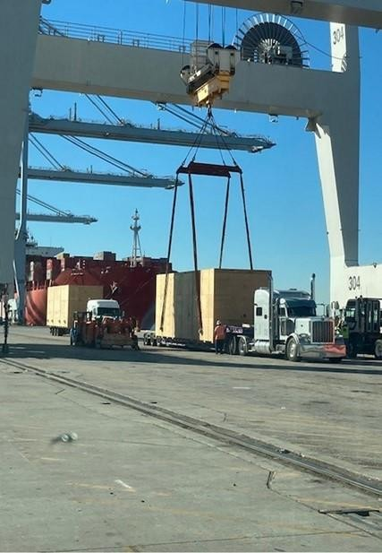
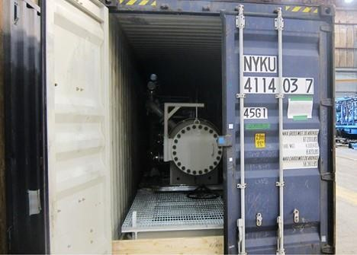
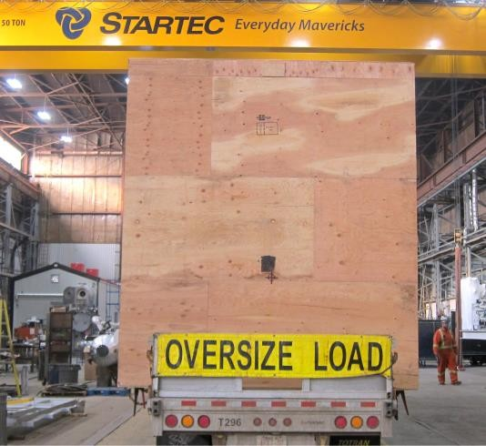
Modularized Designs-International
Facility designed for maximum modularization
Packages were designed to fit into 9 standard seacans and 2 crated modules
Packages were fabricated on budget and delivered to Karachi on schedule

Slide 9
Our Place in Innovation – Turning ideas into reality
Detail design and fabrication from a proven design concept
Modularize and optimize existing designs with the end customer in mind.
Scale up and optimize ideas proved in a smaller scale
Support full cycle product development and deployment
Startec Focus Areas:
CO₂ Recovery and Treatment
Sulphur Treating
Flare Gas Capture
CNG and LNG
Biofuel and Hydrogen

Slide 10
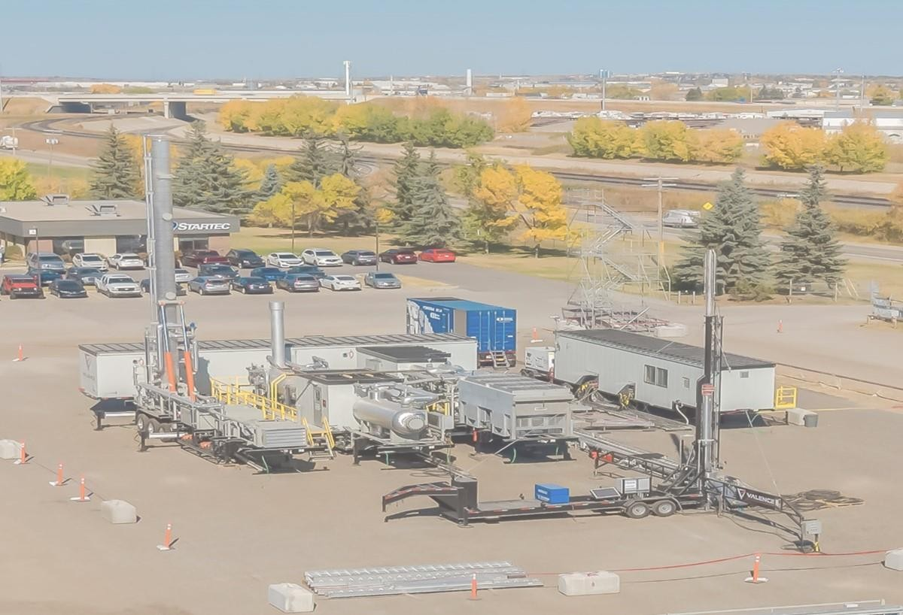
Case Study: Turning innovative ideas into reality

Slide 11
Startec Approach - From Concept to Market
The Challenge
Client was looking for a small-scale modularized gas
processing solution
  Economics highly sensitive to capital
  Mobility and flexibility key
  Looking for solution customizable to varying gas compositions and operating regimes

Slide 12
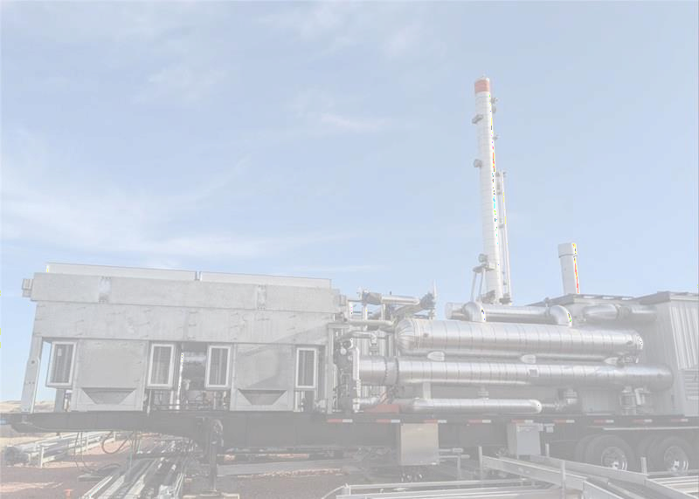
Startec Approach- From Concept to Market
The Outcome:
4mmcf/d Mobile gas processing facility
From initial concept to commercial product in ~ 12 months
30% cost reduction vs. the initial design
First system deployed and operating in North Dakota

Slide 13

Case Study: Co-engineering with Engineering Firm

Slide 14
Startec Advantage - Process Island Overview
Startec worked with Engineering firm and Client to optimize design, cost
and delivery of Client’s northern gas processing plant
Complete process plant all engineered, designed and fabricated:
  200MMscf/day Refrigeration Plant -31F Including:
  10 packaged skids (gas processing, deethanizer, OH compression)
  4 coolers, 1 tower, and 1 feed drum off-skid
  3 pipe racks ~7,200 weld-inches and ~64,200 lbs
  Interconnecting piping (1” to 20”) ~7,600 weld-inches
  Pipe supports and other structural steel ~46,500 lbs
  All Pressure tested insulated and traced
Reduced time and costs
  17 connections at 2 locations vs 132 connections at 16 locations
  Consistency of the design and final product
  Simplicity of engineering coordination
  Improved delivery by
  Cost certainty- project was delivered on-budget

Slide 15
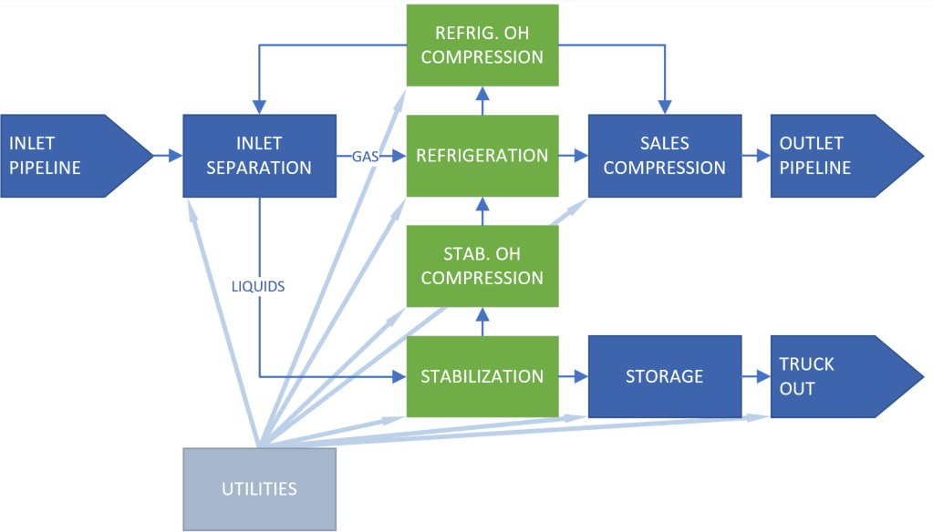
Startec Process Island – Block Flow Diagram
Startec Scope

Slide 16
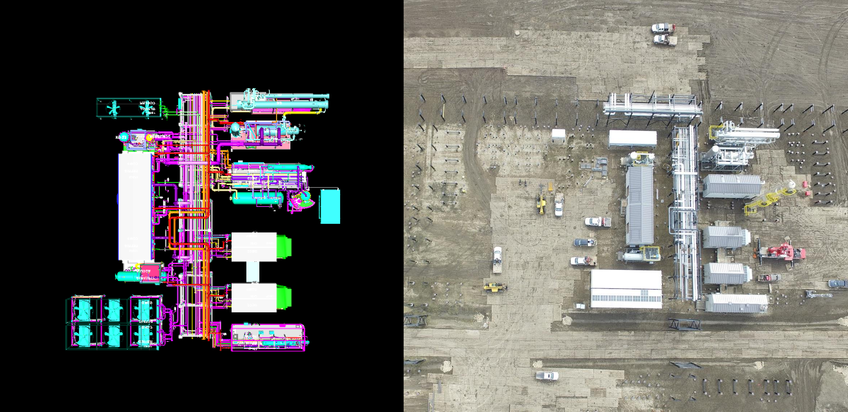
Startec Process Island – Model Shot vs. Photo

Slide 17
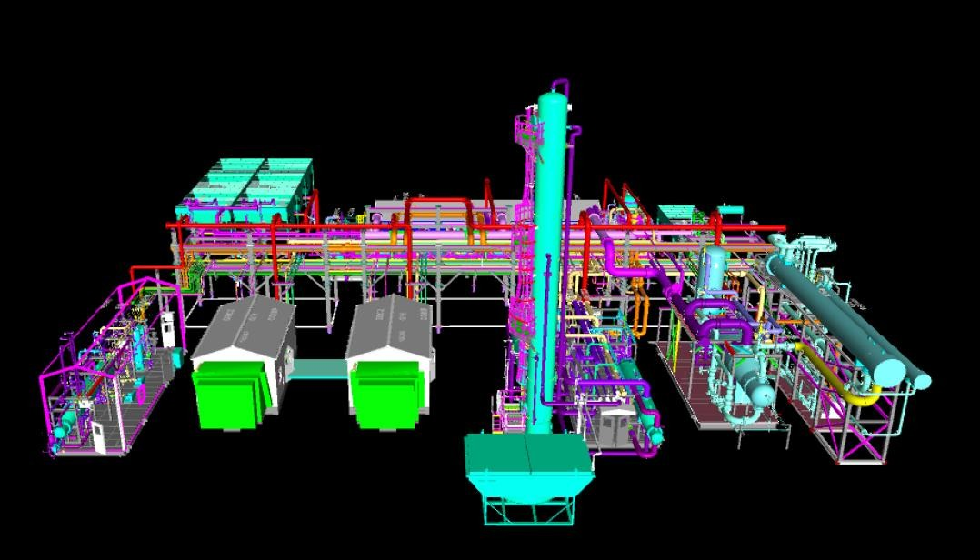
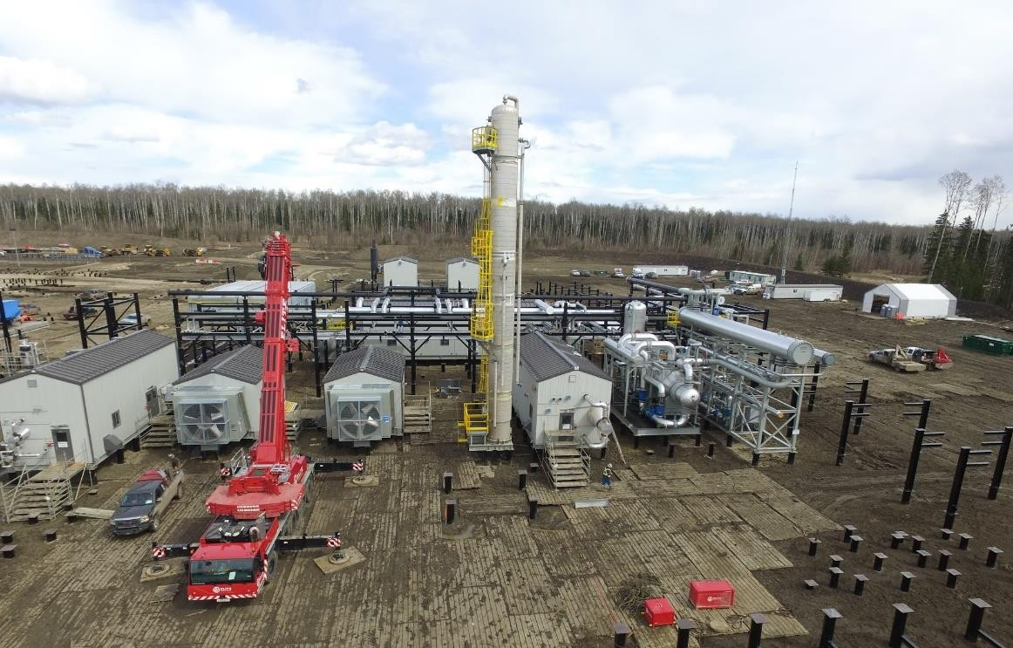
Startec Process Island – Model Shot vs. Photo

Slide 18
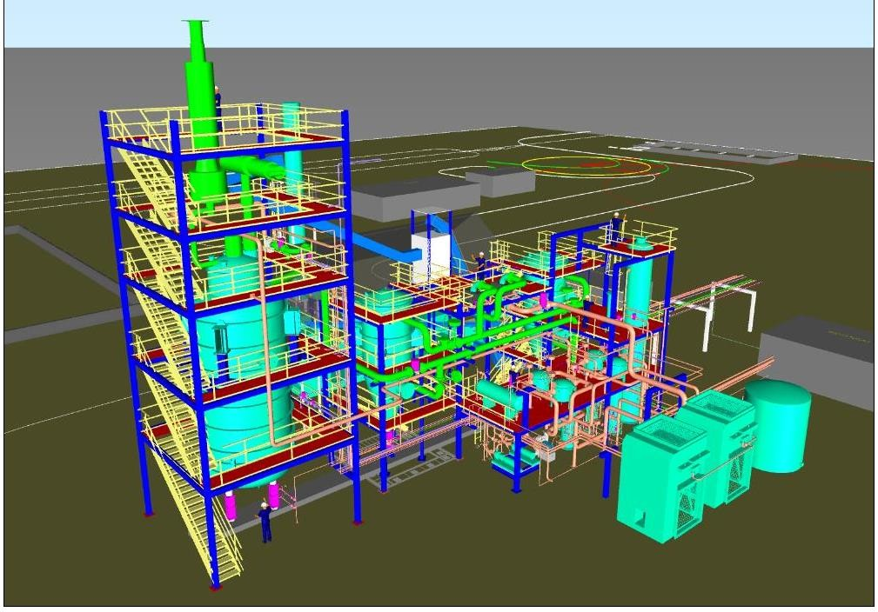
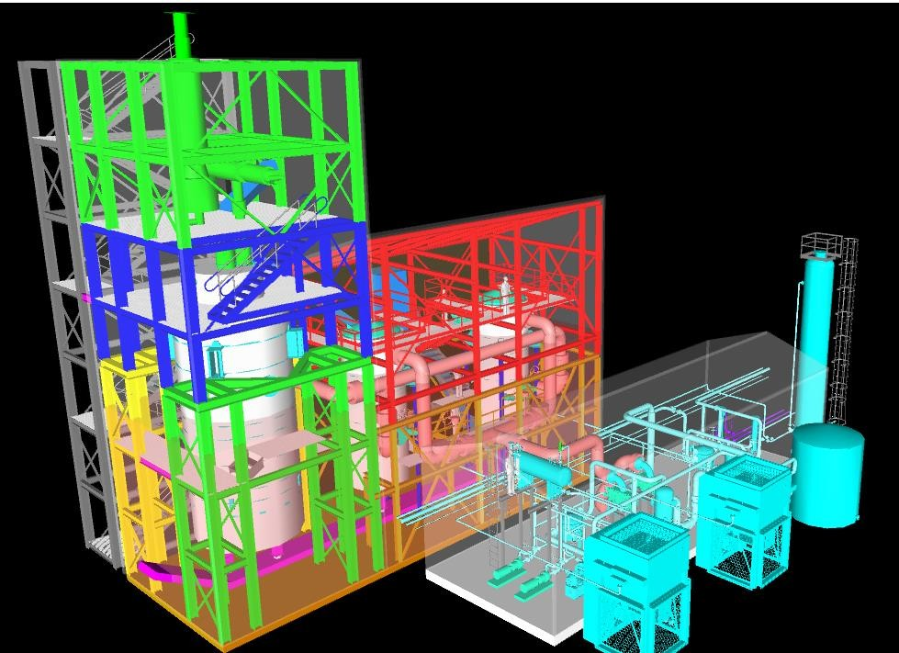
BGTL Example – Startec Design Optimizations
After Startec module optimization
Before – 60% more structural and space required.

Slide 19
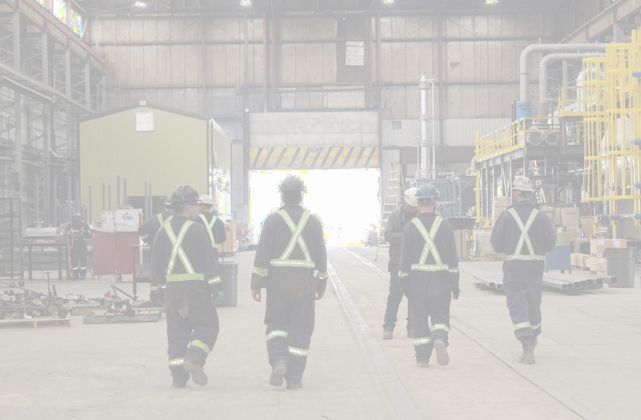
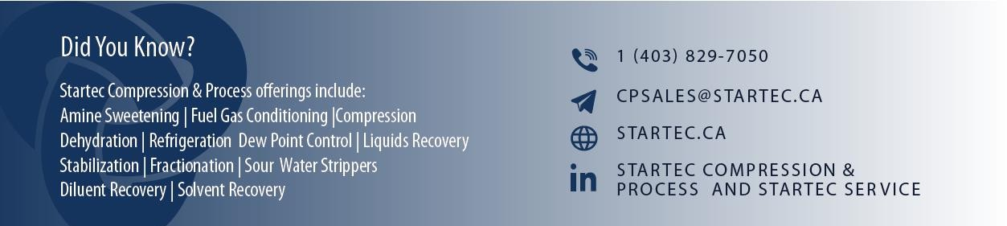
19
Everyday Mavericks

